Slide 1
FAKE NEWS DETECTION FOR CYBERBULLYING.
By Anuhya Peddi

Slide 2
INTRODUCTION
Fake news:
Fake news is false or misleading information presented as news.
It’s about information presented as news that is known by its promoter to be false based on facts that are demonstrably incorrect, or statements or events that verifiably did not happen.
Cyberbullying:
Cyberbullying or cyber harassment is a form of bullying or harassment using electronic means. The use of electronic communication to bully a person, typically by sending messages of an intimidating or threatening nature.
Cyberbullying includes sending, posting, or sharing negative, harmful, false, or mean content about someone else.

Slide 3
CAUSES OF SPREADING FAKE NEWS AND CYBER BULLYING
Can be intentional /unintentional.
Many reasons like anger, jealousy, or for fun.
Not having enough time.
Teenagers having early access to devices and new emerging technologies.
As the use of social media has increased extensively now a days people who rely on these platforms for news and other information can be misleading.

Slide 4
RESEARCH QUESTIONS
Q1. How can fake news detection prevent the cyberbullying?
Q2. Which machine learning algorithm can be used to detect fake news?
Q3. What will the accuracy of algorithm in detecting the fake news?

Slide 5
APPROACH
The approach we are using here is Python and machine learning with logistic regression model.
And the other models that we are comparing with is Random Forest and Support Vector model.
Support Vector model and Logistic regression gives the same accuracy rate when implemented with real time data.
Data Collection
Data is collected from Kaggle in the form of json file by downloading Kaggle API.

Slide 6
APPROACH
Steps to be followed
Data Loading - Collection of data and loading into the process
Data Pre - processing - Processing data to reduce dimensions
Data Transformation - Converting data into numerical type
Data modelling - Data is modelled using Logistic regression
Model evaluation - Metrics used to evaluate data

Slide 7
RESULTS
We have used two metrics, in evaluating the model performance
Accuracy Score.
Confusion Matrix

Slide 8
ACCURACY SCORE
Model | Training Accuracy (Count Vec) | Validation Accuracy (Count Vec) | Testing Accuracy (Count Vec) | Training Accuracy (TFIDF Vec) | Validation Accuracy (TFIDF Vec) | Testing Accuracy (TFIDF Vec)
Logistic Regression | 100% | 58% | 64% | 95% | 46% | 68%
Random Forest | 100% | 64% | 68% | 100% | 63% | 63%
Support vector Machines | 84% | 56% | 75% | 99% | 38% | 67%

Slide 9
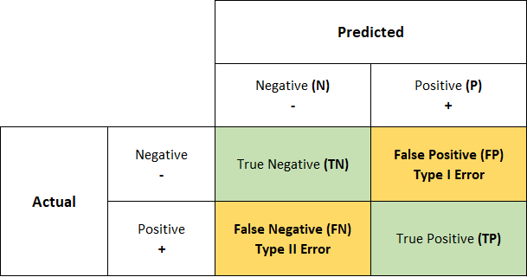
CONFUSION MATRIX
Definition :
It is a process that helps to assess and predict the validity of a classification model. Using confusion matrices allows you to see different errors which you could make when you make predictions.
We also use confusion matrix for F1, precision, recall.

Slide 10
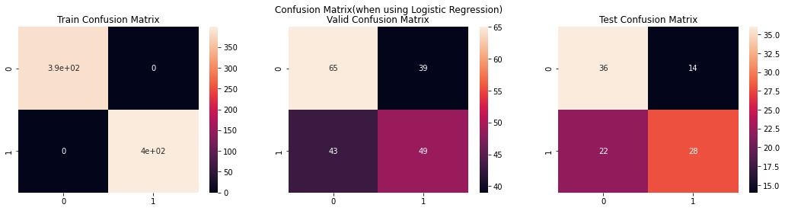
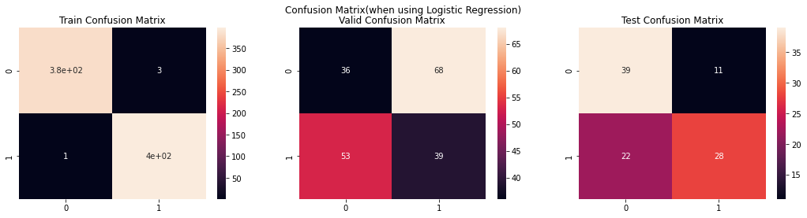
CONFUSION MATRIX FOR lOGISTIC REGRESSION

Slide 11
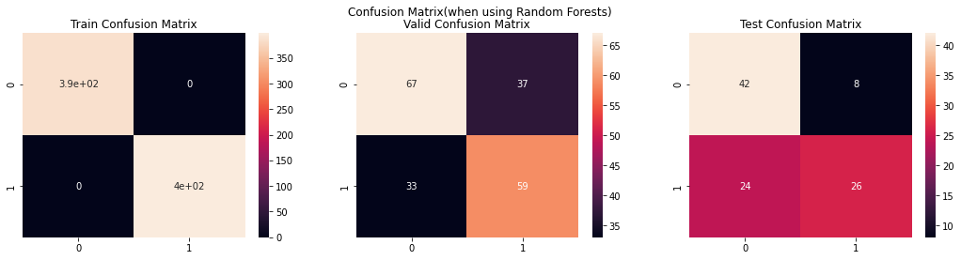
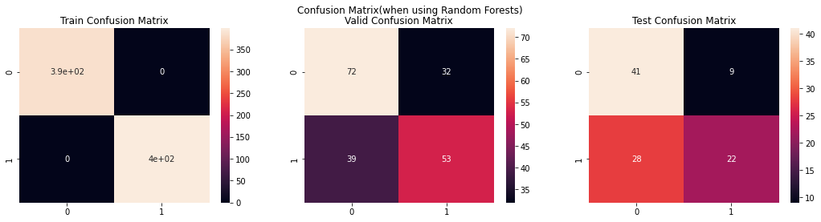
CONFUSION MATRIX FOR RANDOM FOREST

Slide 12
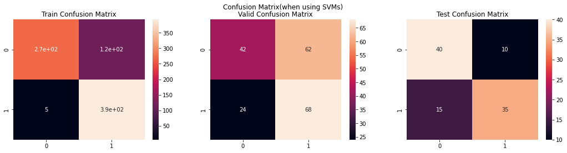
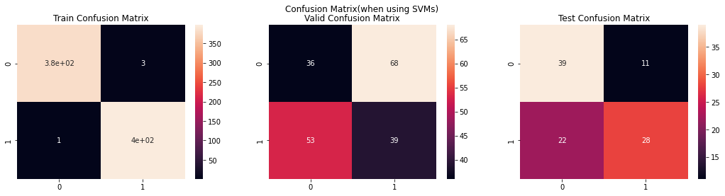
CONFUSION MATRIX FOR SUPPORT VECTOR MACHINES

Slide 13
CONCLUSION
Instead of doing manual process, we are using algorithms. In this model we used logistic Regression, Random Forest and Support vector models. Among them we have high accuracy rate for support vector machines(SVM).

Slide 14
FUTURE WORK
In future we can implement a algorithm which may take input and let us know upto what percentage of the information is real and what if fake in it.
There is still scope of improvement in this domain, the main areas in which we can improve the solution space is:
Use of Deep Learning Models
Use of Pre-trained Embeddings
Word Embeddings
Sentence Embeddings
Use of Pre-trained Model(like Bert and others)

